Slide 1
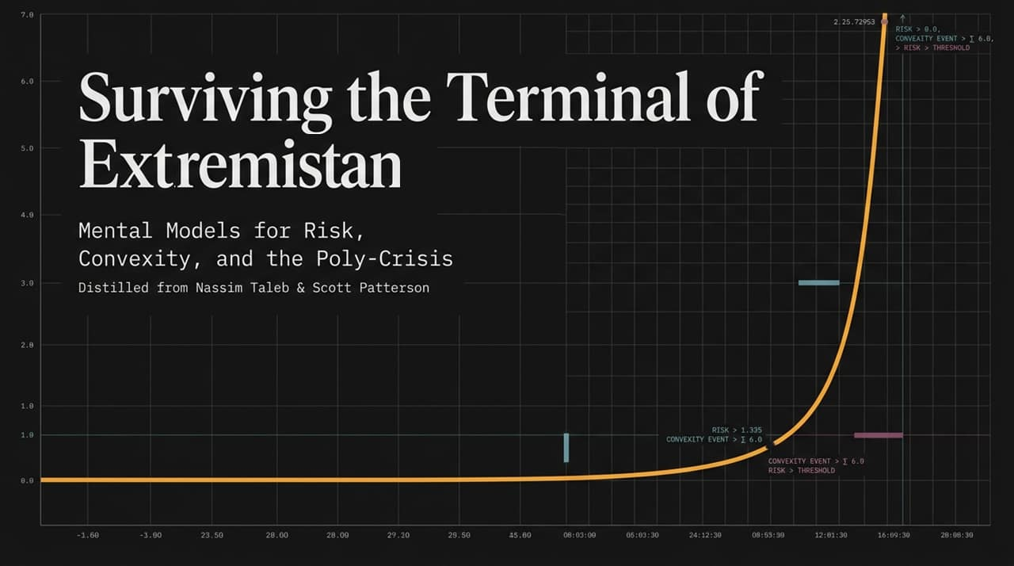
Notes:
https://www.youtube.com/watch?v=18ZxCxN2ZMo
Extremistan 是纳西姆·尼古拉斯·塔勒布（Nassim Nicholas Taleb）在其著作《黑天鹅》（The Black Swan）中提出的一个概念性领域，用来指代那些极端罕见事件（即“黑天鹅事件”）对整体结果具有决定性、颠覆性影响的社会与经济范畴
Objective: Set the stage, introduce the themes of tail risk, the poly-crisis, and Taleb/Patterson’s philosophy.
Speaker Script / Key Points:
Introduction: "Welcome everyone. Today we are diving into the mental models required to navigate an increasingly volatile world—what Nassim Taleb calls Extremistan. Our presentation synthesizes the ideas of Taleb and financial journalist Scott Patterson."
Core Theme: "Most of modern risk management relies on models designed for calm waters. But in a hyper-connected global economy, we face a 'poly-crisis'—where geopolitical, financial, biological, and technological risks interact non-linearly."
Goal of the Presentation: "We aren't here to predict the next crisis—predicting specific Black Swan events is a fool's errand. Instead, we will explore how to structure systems, portfolios, and decisions so that chaos becomes an source of positive convexity and anti-fragility rather than terminal ruin."

Slide 2
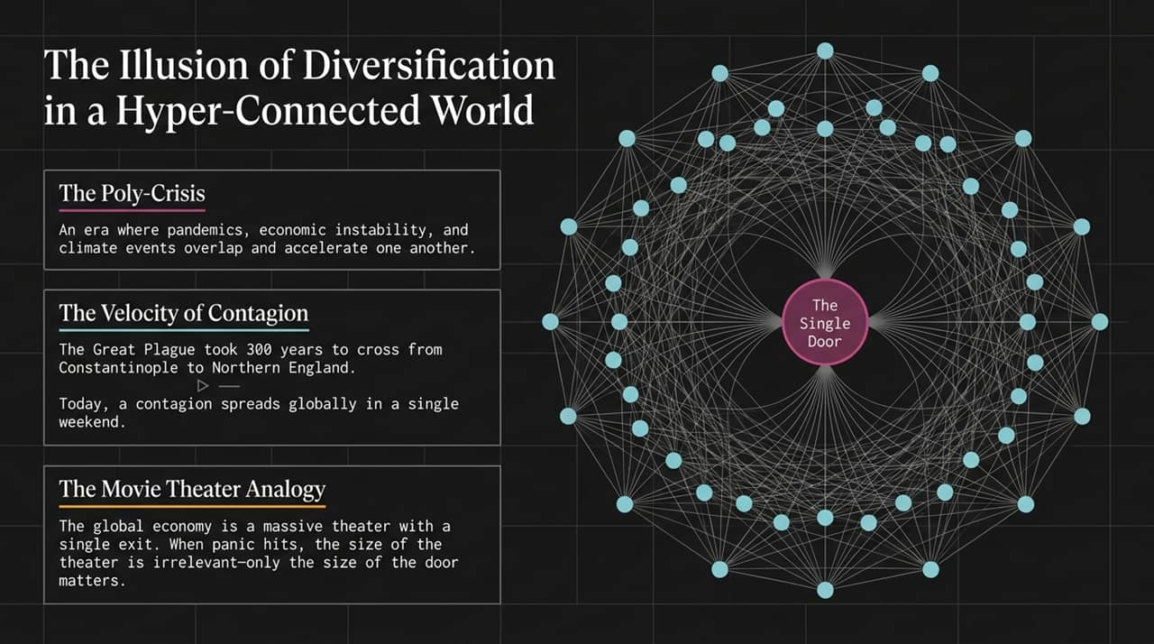
Notes:
Objective: Explain why traditional portfolio diversification fails during systemic crashes due to network speed and single-point bottlenecks.
Speaker Script / Key Points:
The Poly-Crisis: "We used to think of economic, environmental, and health crises as isolated events. Today, they overlap and amplify each other."
Velocity of Contagion: "In his interview with Tim Ferriss, Nassim Taleb points out a striking historical contrast: The Great Plague took over 300 years to travel from Constantinople to Northern England. Why? Because travel was constrained by land and slow sailing ships. Today, a pathogen or financial panic boards a commercial flight and circles the globe in a single weekend."
The Single Door Analogy: "Imagine a grand, luxurious movie theater. It doesn't matter how big or diversified the seating area is—if panic breaks out, everyone rushes to a single exit door. In markets, liquidity vanishes during a crash, turning thousands of 'diversified' assets into one crowded exit."

Slide 3
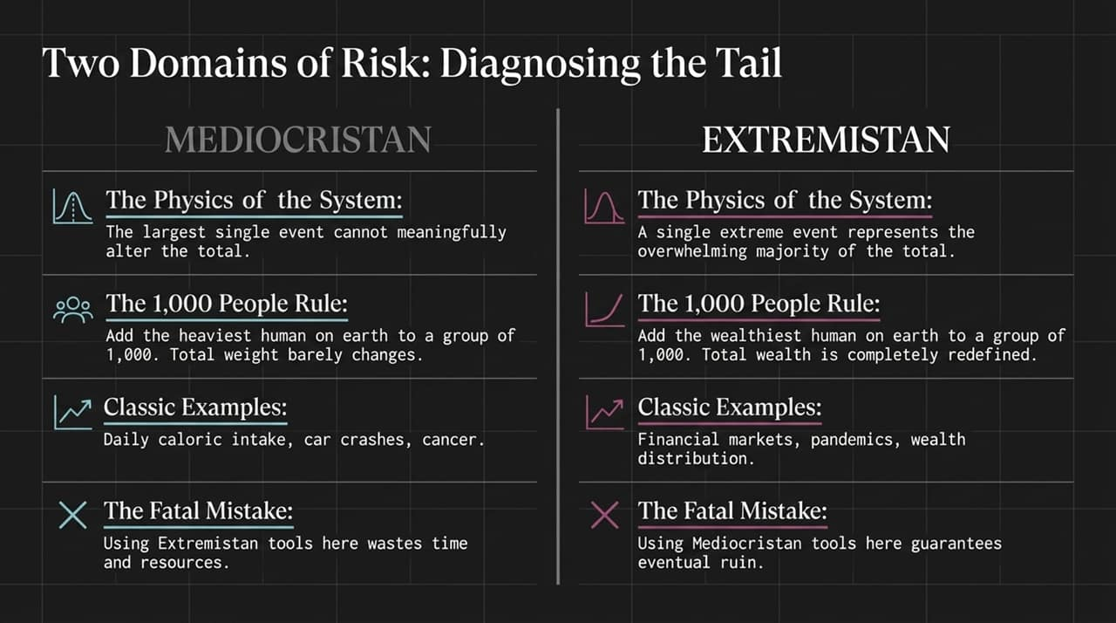
Notes:
Objective: Differentiate between Mediocristan (thin-tailed risks) and Extremistan (fat-tailed risks).
Speaker Script / Key Points:
Mediocristan (Thin Tails): "In Mediocristan, individual observations cannot significantly alter the total. Taleb uses the '1,000 People Rule': If you gather 1,000 people in a room and add the heaviest human on Earth, the average weight barely moves. Physical traits, car accidents, and caloric intake live here."
Extremistan (Fat Tails): "Extremistan operates under entirely different physics. If you take 1,000 people and add Elon Musk or Jeff Bezos, total wealth is completely redefined—a single observation accounts for 99.9% of the whole. Financial markets, social media virality, and global pandemics exist in Extremistan."
The Fatal Mistake: "Using Gaussian (bell-curve) tools designed for Mediocristan inside Extremistan guarantees eventual, total ruin."

Slide 4
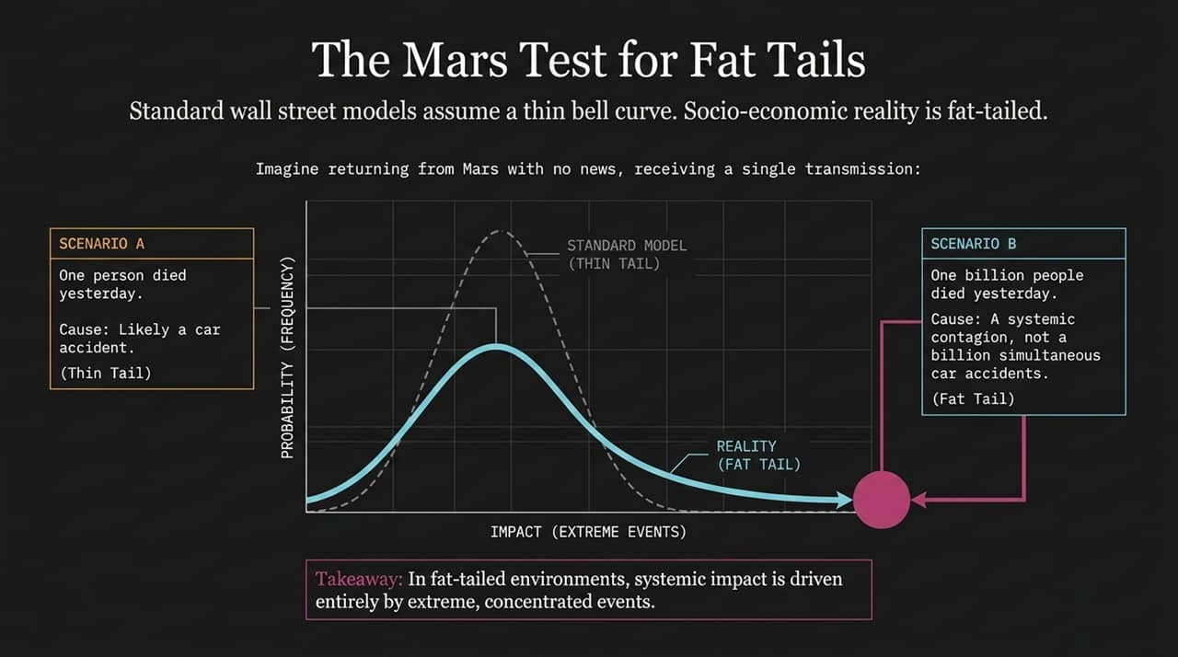
Notes:
Objective: Use a thought experiment to illustrate how fat-tailed risks originate from systemic linkages rather than independent events.
Speaker Script / Key Points:
The Mars Experiment: "Imagine returning from a multi-year space mission to Mars with zero news updates. You receive a single transmission."
Scenario A (1 Death): "If the message says 1 person died yesterday, you naturally assume an isolated, independent event—a car crash or medical issue. This is thin-tailed thinking."
Scenario B (1 Billion Deaths): "If the message says 1 billion people died yesterday, you know with near certainty that it wasn't a billion people having independent car crashes at the exact same moment. It was a systemic contagion or global catastrophe."
Takeaway: "In fat-tailed environments, systemic impact is driven by rare, hyper-concentrated tail events, not by the accumulation of standard daily fluctuations."

Slide 5
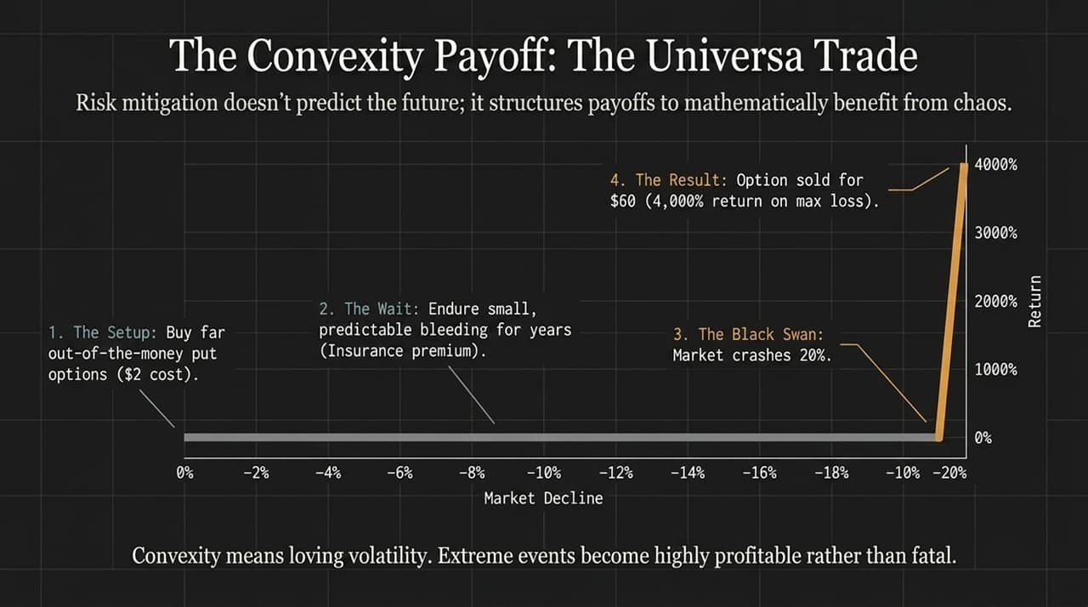
Notes:
Objective: Introduce Universa Investments' tail-hedging mechanics (Mark Spitznagel & Nassim Taleb).
Speaker Script / Key Points:
Structural Asymmetry: "Tail hedging isn't about forecasting when the market will crash. As Scott Patterson notes, Universa and Mark Spitznagel explicitly admit they cannot predict market timing. Instead, they structure payoffs mathematically."
The Mechanics:
The Setup: Consistently purchase far out-of-the-money (OTM) put options for small costs.
The Wait: Endure tiny, predictable annual losses—viewed strictly as an insurance premium.
The Event: When a 20% crash occurs, volatility surges.
The Result: The option value explodes, yielding up to 4,000% returns relative to maximum risk.
Positive Convexity: "This asymmetry means you love volatility. Your maximum loss is strictly bounded, while your upside in a crisis is massive."

Slide 6
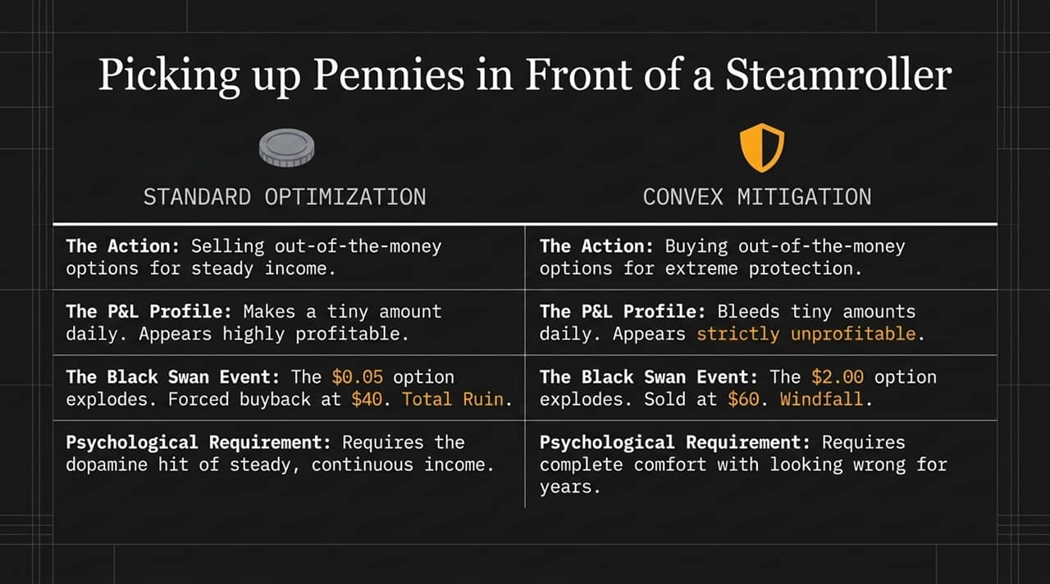
Notes:
Objective: Contrast standard Wall Street yield optimization with convex tail protection.
Speaker Script / Key Points:
Standard Optimization: "Most institutional strategies try to generate steady yield by selling out-of-the-money options. They pick up tiny premiums day after day, producing smooth return charts that look incredibly profitable."
The Hidden Risk: "This is literally picking up pennies in front of a steamroller. When a Black Swan hits, that $0.05 option sold explodes to $40, causing instant insolvency."
Psychological Barrier: "Convex mitigation requires paying a small bleeding cost continuously. Human psychology craves constant dopamine hits from small wins, making true tail protection psychologically difficult for most fund managers to execute."

Slide 7
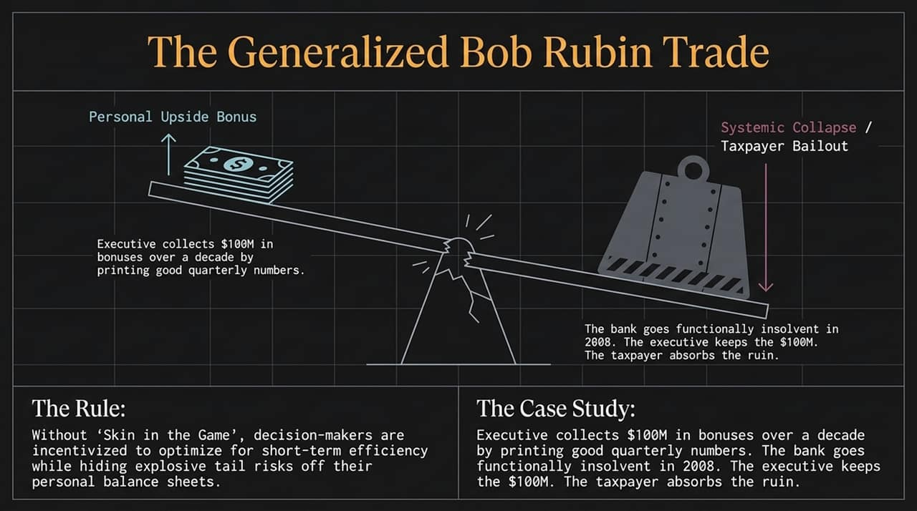
Notes:
Objective: Discuss moral hazard, agency problems, and the requirement for 'Skin in the Game'.
Speaker Script / Key Points:
The Scenario: "Named after former Treasury Secretary Bob Rubin, this trade highlights a severe systemic flaw: asymmetric incentive structures."
Mechanism: "A bank executive collects $100 million in bonuses over a decade by taking hidden, explosive tail risks that produce short-term quarterly profits. When the system collapses in 2008, the executive keeps the $100M bonus, while taxpayers absorb the bailout."
Skin in the Game: "Without skin in the game, decision-makers are incentivized to transfer downside risks onto society while privatizing short-term gains."

Slide 8
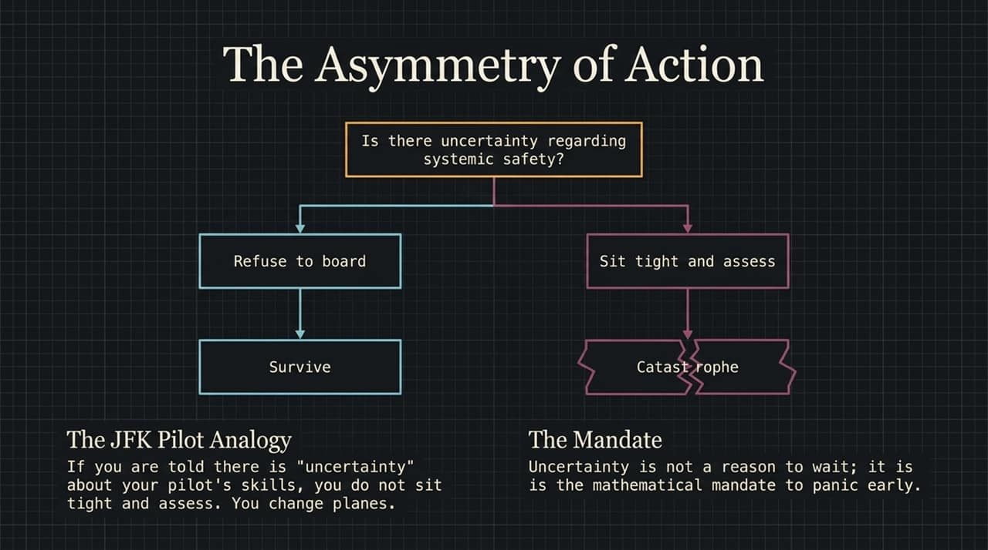
Notes:
Objective: Explain why uncertainty demands early, aggressive precaution rather than delayed assessment.
Speaker Script / Key Points:
The JFK Pilot Analogy: "Imagine standing at JFK Airport. Someone tells you there is uncertainty about whether the pilot is intoxicated or qualified to fly. You do not board the plane and say 'let's sit tight and assess'. You change flights immediately."
The Mandate: "When systemic safety is at stake, uncertainty is not an excuse to wait for more data. In fat-tailed environments, waiting for certainty means acting only after the contagion has spread exponentially. Uncertainty is the mathematical mandate to panic early."

Slide 9
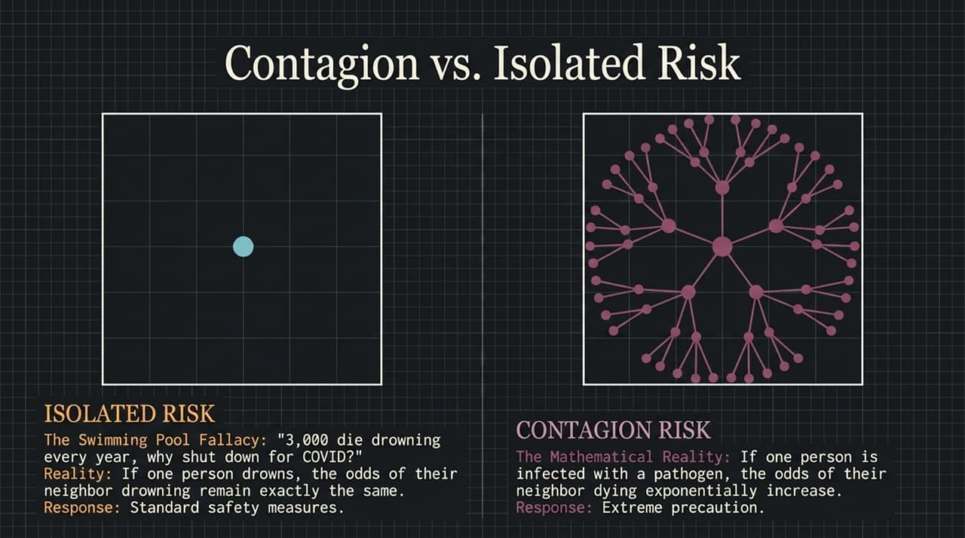
Notes:
Objective: Highlight the logical fallacy of comparing additive risks with multiplicative, contagious risks.
Speaker Script / Key Points:
The Swimming Pool Fallacy: "During early stages of a pandemic, a common argument is: '3,000 people drown in swimming pools every year, so why shutdown the economy for COVID?'"
Mathematical Difference: "Drowning is an isolated, independent risk. If your neighbor drowns, your probability of drowning remains unchanged. Contagion risk is multiplicative: if your neighbor contracts a virus, your personal probability of infection skyrockets exponentially."

Slide 10
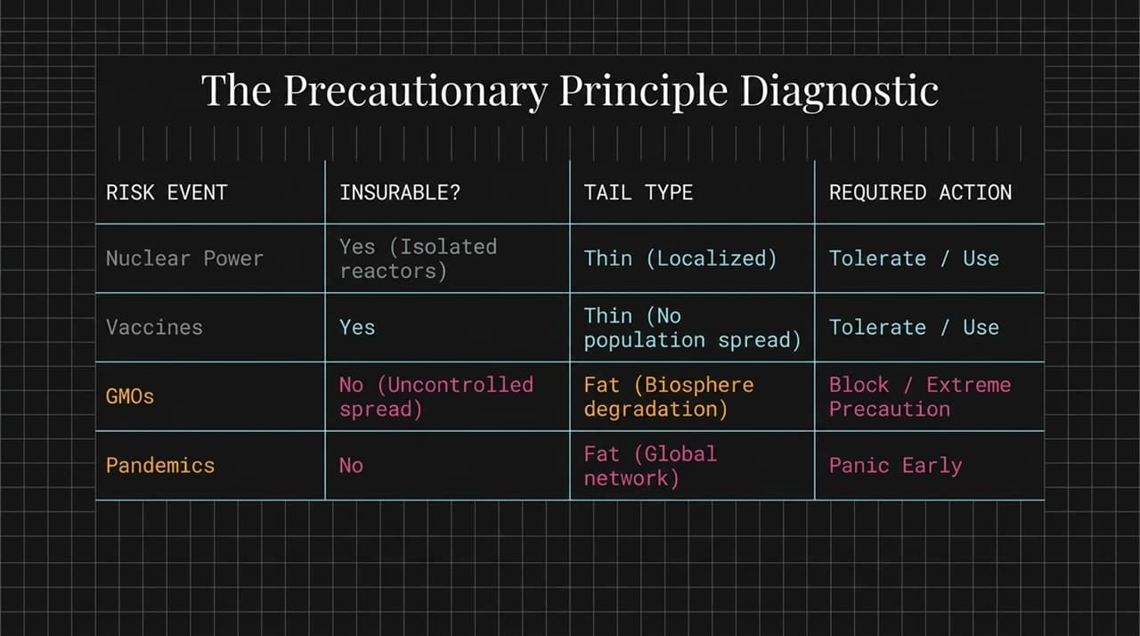
Notes:
Objective: Provide a practical diagnostic framework for applying extreme precaution versus standard risk management.
Speaker Script / Key Points:
Diagnostic Criteria: "We classify risks based on two criteria: Are they insurable/localized? Are they thin-tailed or fat-tailed?"
Nuclear Power & Vaccines: "Localized, thin-tailed risks can be analyzed and managed with standard cost-benefit analyses."
GMOs & Pandemics: "Systemic risks with non-zero probability of irreversible global degradation (like systemic biological disruptions or global pandemics) belong to Extremistan. Here, cost-benefit analysis fails because total ruin has infinite negative utility. The only valid action is extreme precaution and blocking systemic tail risks."

Slide 11
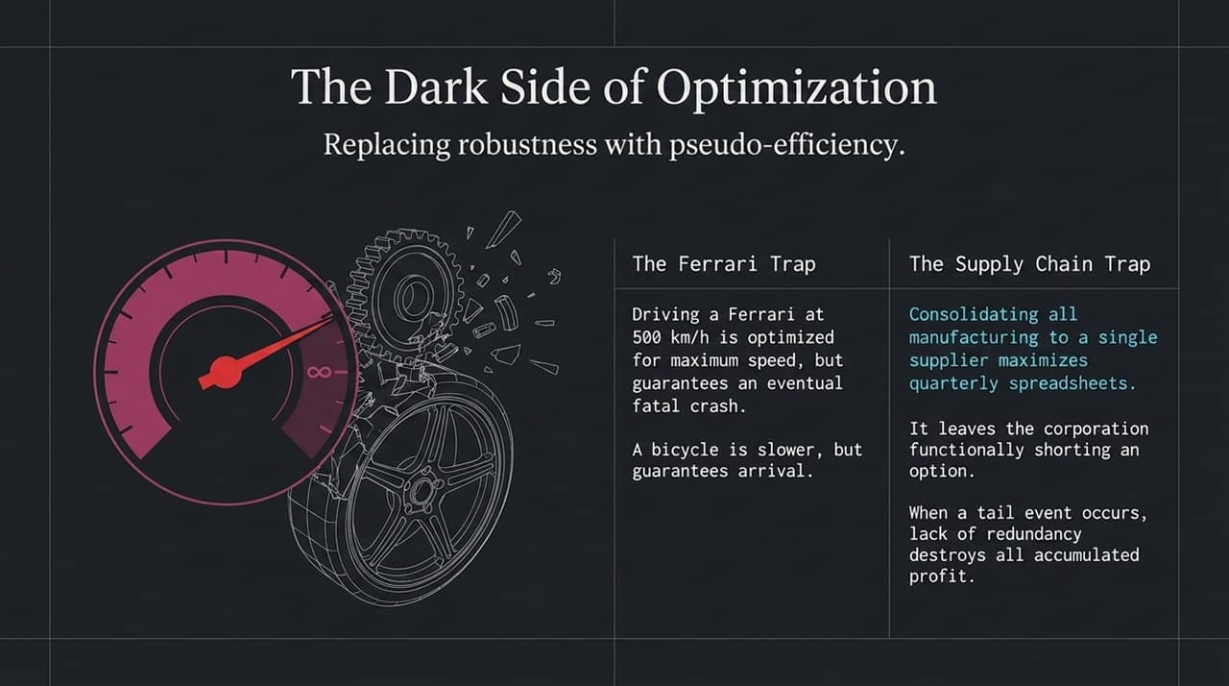
Notes:
Objective: Explain how hyper-efficiency removes buffers, turning systems fragile.
Speaker Script / Key Points:
The Ferrari Trap: "A Ferrari traveling at 500 km/h is hyper-optimized for speed. But the smallest pebble on the road guarantees a fatal crash. A bicycle is far less efficient, but robust."
Supply Chains: "Consolidating all manufacturing to a single cheap supplier optimizes quarterly profits on a spreadsheet. However, it effectively short-sells an option on global supply stability. When a tail event occurs, the complete lack of redundancy destroys decades of accumulated savings."

Slide 12
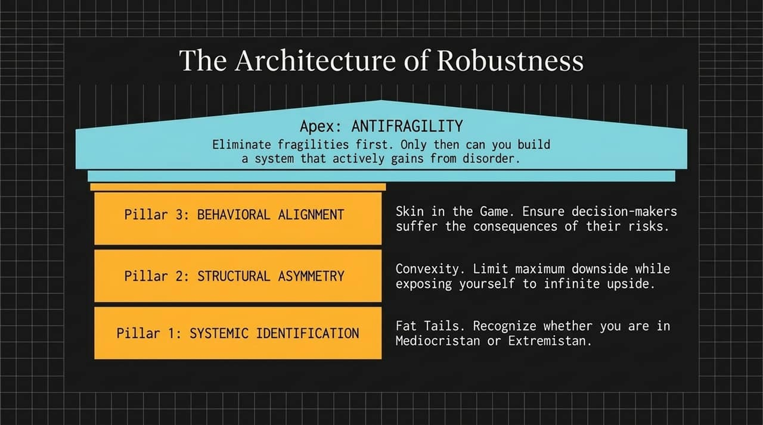
Notes:
Objective: Present the 3-pillar framework culminating in Antifragility.
Speaker Script / Key Points:
Pillar 1 — Systemic Identification: "Know whether you are operating in Mediocristan or Extremistan."
Pillar 2 — Structural Asymmetry: "Ensure positive convexity—cap your maximum downside while leaving upside open."
Pillar 3 — Behavioral Alignment: "Enforce Skin in the Game for decision-makers."
Apex: "Eliminate fragilities first. Only once a system is immune to total ruin can it benefit from disorder and reach Antifragility."

Slide 13
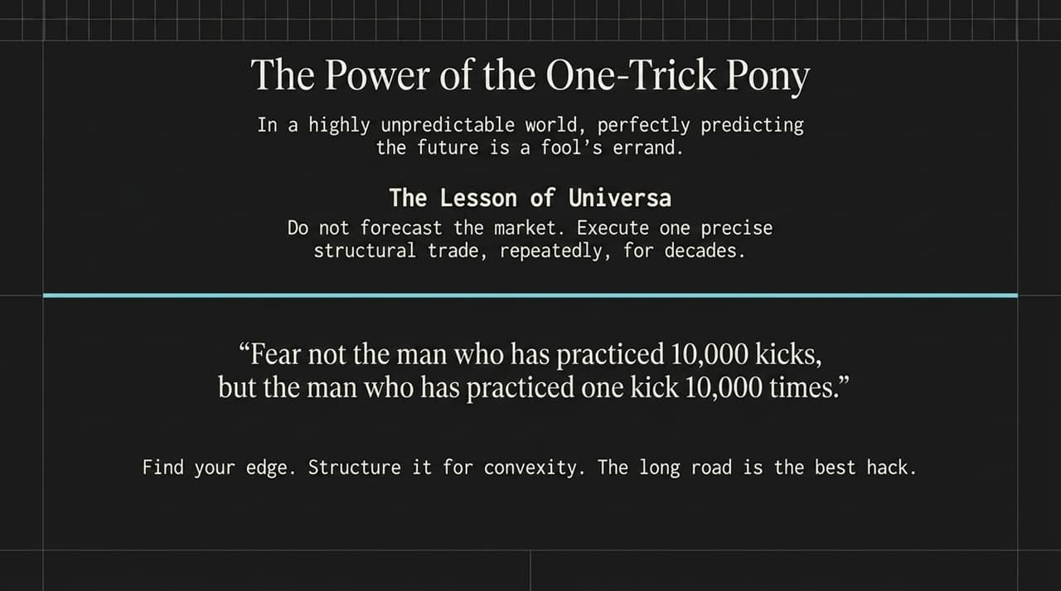
Notes:
Objective: Emphasize focus and repeatable execution over complex market forecasting.
Speaker Script / Key Points:
Universa’s Edge: "As Taleb noted in the Ferriss interview, while he transitioned to research and writing, Mark Spitznagel dedicated decades solely to perfecting one exact structural trade."
The Bruce Lee Philosophy: "'I fear not the man who has practiced 10,000 kicks once, but the man who has practiced one kick 10,000 times.'"
Key takeaway: "Stop trying to predict complex future scenarios. Find one clear convex edge, structure it properly, and execute it relentlessly."

Slide 14
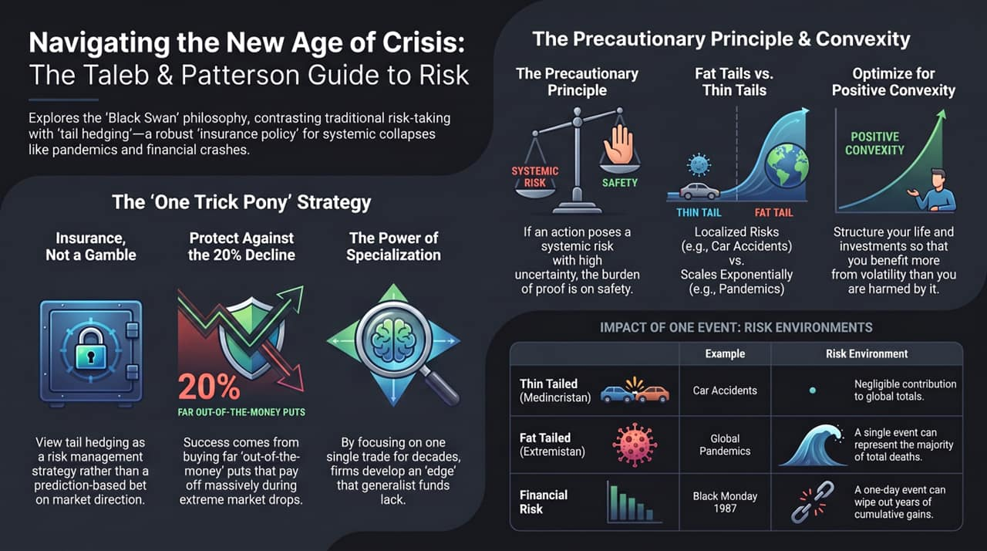
Notes:
Objective: Wrap up the core lessons from Taleb and Patterson as a practical blueprint for risk navigation.
Speaker Script / Key Points:
Core Summary:
Tail Protection as Insurance: Tail-hedging is a risk management tool, not a direction-based market gamble.
Far Out-of-the-Money Options: Use hyper-asymmetric positions to protect portfolios against >20% market declines.
Precautionary Principle: When facing fat-tailed systemic risks, act early and decisively.
Final Thought: "In an era defined by the poly-crisis, survival belongs to those who eliminate fragilities and master positive convexity."

